Slide 1
Intermittent-Energy Bio-Sensors
Audrey and Dill

Slide 2
Mission Statement
For hardware engineers who need to build tiny, battery-less medical sensors, the Intermittent Computing Prototype is a custom hardware simulation that guarantees a device can finish its work on low power.
Unlike traditional computer chips that wipe their memory and reboot every time the voltage drops, it saves the sensor's exact progress to permanent memory and resumes when energy returns.
Notes:
For hardware engineers who need to build tiny, battery-less medical sensors, the Intermittent Computing Prototype is a custom software simulation that guarantees a device can finish its work on weak, flickering power.
Unlike traditional computer chips that wipe their memory and reboot every time the voltage drops, it saves the sensor's exact progress to permanent memory and resumes when energy returns.

Slide 3
User Stories
RTL Designer pt.1
Systems Engineer
RTL Designer pt.2
Notes:
As an RTL designer, I want a dedicated "Survival Controller" FSM that listens for a low-voltage interrupt, so that the chip can instantly halt the main processor.
As a systems engineer, I want the FPGA to automatically serialize and send all in-progress data to the FRAM, so that the chip doesn't lose its intermediate math.
As an RTL designer, I want the chip's boot-up sequence to default to checking the FRAM first, so that the system restores its saved progress rather than starting from zero.

Slide 4
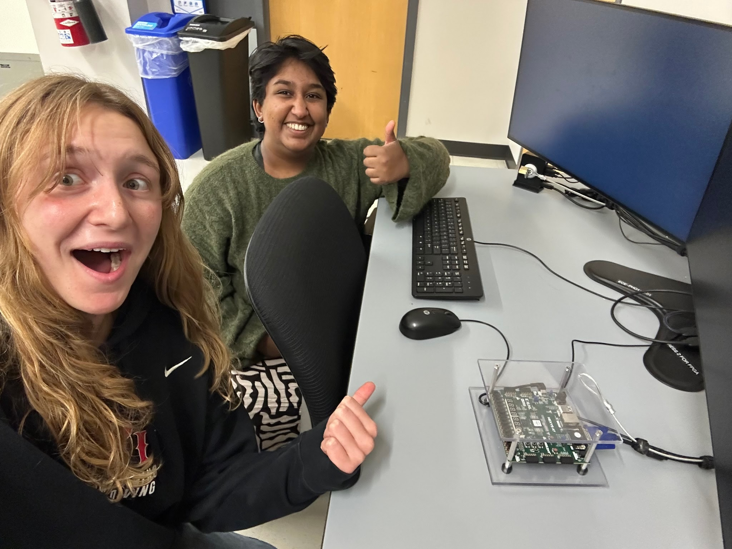
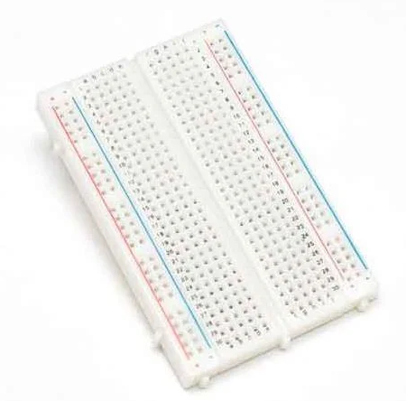

Tools
Breadboard/circuitry
FPGA
Xilinx
Notes:
Breadboard & electronics - simulating a voltage drop
FPGA - to write and run a simulated biosensor
Xilinx - to simulate and synthesize our code

Slide 5
Progress Made
Outline
Materials
Research
Notes:
Outlined our teams methods of communication and laid the foundation for the rest of the project
Collected our necessary materials to implement our project
Done background research to form a basis of knowledge for the project

Slide 6
What We’ve Learned
New power options for medical devices
Problems and solutions to those new power options
How to translate this solution into a hardware.software simulation
Notes:
Next generation devices replacing batteries with ambient energy harvesters to solve size and safety problems
but it introduces issues with reliability
Solution: Intermittent computing. By building smart circuits that instantly save their work to permanent memory the moment power drops, the device can pick up exactly where it left off when power returns.
Design an intermittent controller FSM that simulates the lifecycle of a ambient-energy harvesting device. Show this on an FPGA device.

Slide 7
Sprint 2 Goals
User story:
“As an RTL designer, I want a dedicated "Survival Controller" FSM that listens for a low-voltage interrupt, so that the chip can instantly halt the main processor.”
Tasks needed:
Breadboard to simulate interrupt - interactable, in-person.
FSM which sets an interrupt when voltage starts dropping.
FSM-to-breadboard connection.
Our riskiest assumption - will voltage drop slowly enough for the FSM to work?

